Slide 1

Project On
Indian Institute Of Technology, Bombay
For Prayagraj
Student Name: Riya Sunil Kharade
Guided BY : Prof. Gulab Singh
Subject : Microwave Satellite Data Processing
College Name: Vidyalankar Institute of technology Mumbai
Duration: 5 June- 14 June

Slide 2
Chapter 1 – C2 Matrix & Decomposition
Generate C2 Matrix and PC, PV, PG Decomposition
Used Sentinel-1A SAR data (Prayagraj A & B)
Processing in SNAP:
Split → Calibration → Deburst → Subset
Matrix generation → Coregistration
Multilooking → Speckle filtering → Band math for PV, PC, PG
RGB generation from decomposition

Slide 3
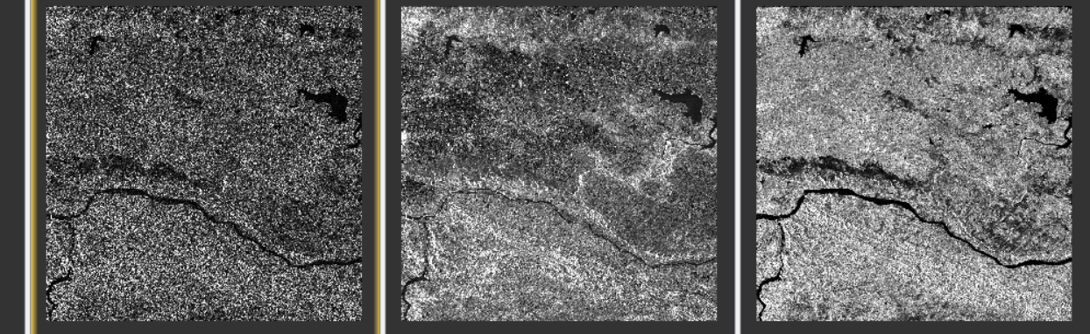
Chapter 1 – Results & Discussion
PC PG PV
Surface Scattering Double Bound Scattering Volume Scattering

Slide 4
Chapter 2 – Classification Using Random Forest
Target Feature & Random Forest Classification
Used Sentinel-1A (Prayagraj)
Identified target features from RGB
Applied Random Forest classifier
Accuracy will be assessed later

Slide 5
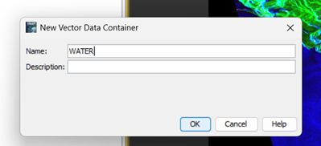
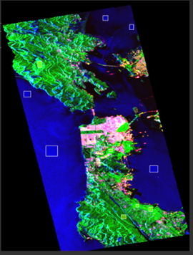
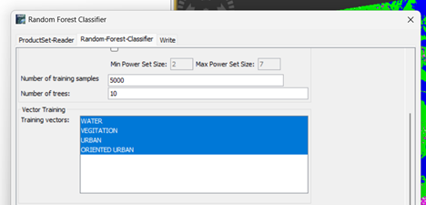
Chapter 2 – Results & Discussion

Slide 6
Chapter 3 – Polarimetric Classification (ALOS)
PolSAR Classification Using ALOS Data
ALOS PolSAR dataset (different from Prayagraj)
SNAP steps:
Install data → Calibration → T3 matrix
Multilooking → Polarimetric Speckle Filtering
Terrain correction → Import T3 in SNAP
RGB and classification in QGIS
Freeman, Singh4Gauss, Singh7SD, Yamaguchi

Slide 7
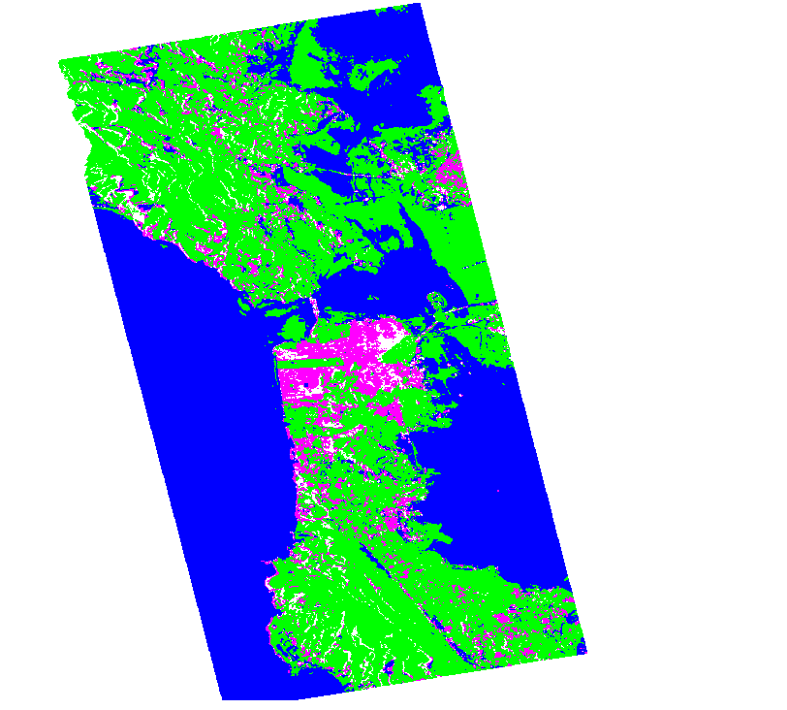
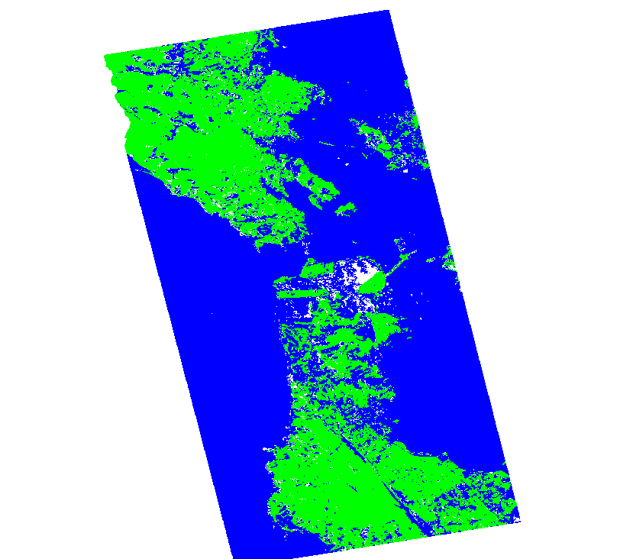
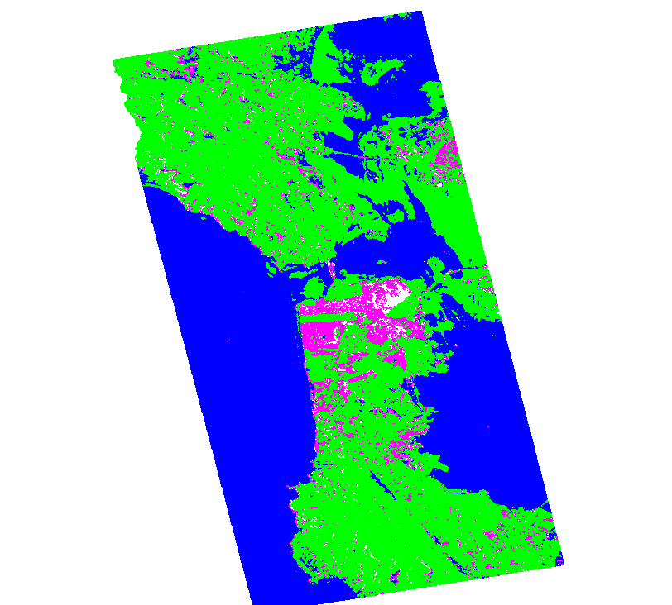
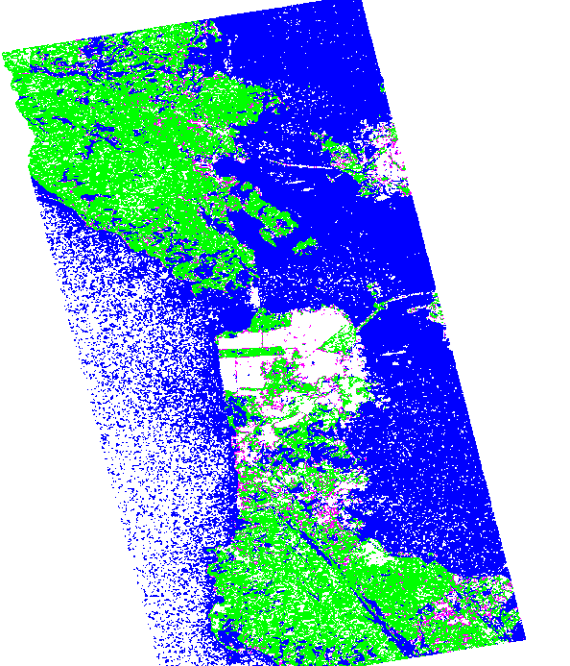
Chapter 3 – Results
Freeman–Durden
Decomposition
Singh 4-Component
Singh 7-Component
Singh Improved 6-Component

Slide 8
Chapter 4 – Interpret the target features and using these target features classify ll decomposition images with RF classifier and compare acuracies
PolSAR Classification Using Prayagraj Data
Prayagraj PolSAR dataset
SNAP steps:
Install data → Calibration → T3 matrix
Multilooking → Polarimetric Speckle Filtering
Terrain correction → Import T3 in SNAP
RGB and classification in QGIS
Freeman, Singh4Gauss, Singh7SD, Yamaguchi

Slide 9
Chapter 5 – Generate DEM of Your Study Area
Generate a Digital Elevation Model (DEM) using Sentinel-1 SAR data.
Steps Followed:
Split – Extract relevant bursts
Calibration – Convert to sigma naught
Deburst – Merge image bursts
Co-registration – Align master and slave images
Interferogram Generation – Compute phase difference
Filtering – Reduce noise (Goldstein filter)
Unwrapping – Convert phase to height (optional)
Terrain Correction – Geocode and correct distortions

Slide 10
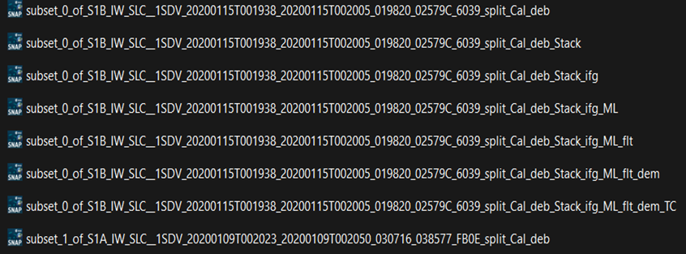
Chapter 5 – Results

Slide 11
Summary & Key Learnings
Learned SAR and PolSAR processing in SNAP
Applied classification and decomposition methods
Understood the use of DEM and terrain correction
Worked with both Sentinel-1 and ALOS data

Slide 12
THANK YOU !

